Slide 1
Pipeline transformation

Slide 2
三维空间几何元素的表示
Point: Coordinates (x, y, z)
Plane: Normal Vector (A, B, C), Distance D from the Original
A² + B² + C² = 1
Ax + By + Cz ± D = 0
It’s easy to represent them by coordinates or equations uniquely
Can we express a line in 3D space uniquely?

Slide 3
齐次坐标下的平面方程
Ax / w + By / w + Cz / w + D = 0
等价于
Ax + By + Cz + Dw = 0
表示三维直线需要两个平面：
A₁x + B₁y + C₁z + D₁w = 0
A₂x + B₂y + C₂z + D₂w = 0
但平面不是唯一的，如何唯一表示？

Slide 4
四维空间中的二维子空间
A₁x + B₁y + C₁z + D₁w = 0
A₂x + B₂y + C₂z + D₂w = 0
[A₁, B₁, C₁, D₁]^{T}和[A₂, B₂, C₂, D₂]^{T}构成四维空间中的两个基向量
方程组的解也是四维空间中的二维子空间
问题转化为：如何在四维空间中唯一表示二维子空间？

Slide 5
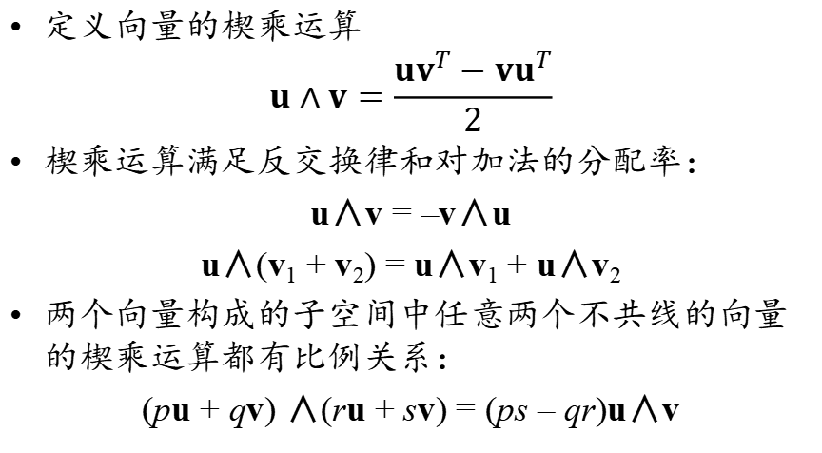
楔乘运算
定义向量的楔乘运算
$$u∧v=\frac{uv^{T}−vu^{T}}{2}$$
楔乘运算满足反交换律和对加法的分配率：
u∧v = –v∧u
u∧(v₁ + v₂) = u∧v₁ + u∧v₂
两个向量构成的子空间中任意两个不共线的向量的楔乘运算都有比例关系：
(pu + qv) ∧(ru + sv) = (ps – qr)u∧v

Slide 6
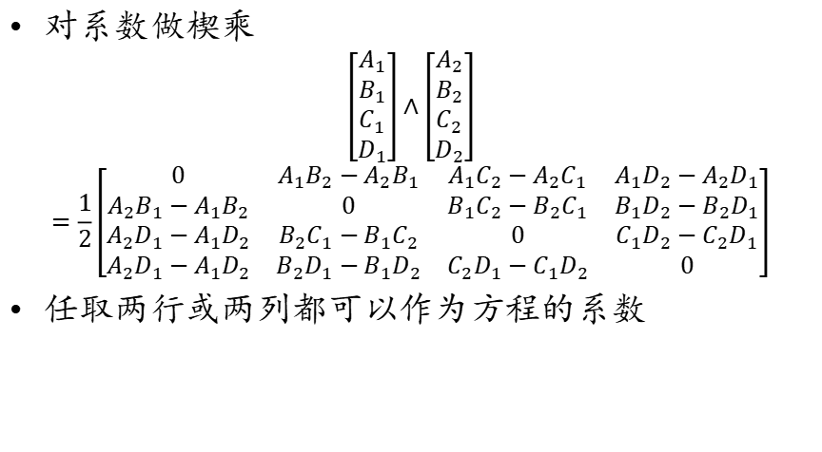
二维子空间的唯一表示
对系数做楔乘
$$\left[\begin{matrix}A_{1} \\ B_{1} \\ C_{1} \\ D_{1}\end{matrix}\right]∧\left[\begin{matrix}A_{2} \\ B_{2} \\ C_{2} \\ D_{2}\end{matrix}\right]$$
$$=\frac{1}{2}\left[\begin{matrix}0 & A_{1}B_{2}−A_{2}B_{1} & A_{1}C_{2}−A_{2}C_{1} & A_{1}D_{2}−A_{2}D_{1} \\ {A_{2}B_{1}−A}_{1}B_{2} & 0 & B_{1}C_{2}−B_{2}C_{1} & B_{1}D_{2}−B_{2}D_{1} \\ {A_{2}D_{1}−A}_{1}D_{2} & {B_{2}C_{1}−B}_{1}C_{2} & 0 & C_{1}D_{2}−C_{2}D_{1} \\ {A_{2}D_{1}−A}_{1}D_{2} & B_{2}D_{1}−B_{1}D_{2} & {C_{2}D_{1}−C}_{1}D_{2} & 0\end{matrix}\right]$$
任取两行或两列都可以作为方程的系数

Slide 7
三维空间中的正多面体
每个面都是正多边形，每个顶点周围的面数相同的多面体称为正多面体

Slide 8
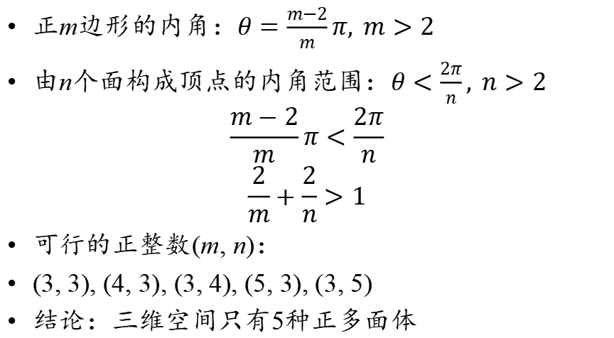
构成正多面体的条件
正m边形的内角：$θ=\frac{m−2}{m}π, m>2$
由n个面构成顶点的内角范围：$θ<\frac{2π}{n}, n>2$
$$\frac{m−2}{m}π<\frac{2π}{n}$$
$$\frac{2}{m}+\frac{2}{n}>1$$
可行的正整数(m, n)：
(3, 3), (4, 3), (3, 4), (5, 3), (3, 5)
结论：三维空间只有5种正多面体

Slide 9
笛卡尔定理
v_{i}
δ(v_{i})
v_{i}
与球面同胚的多面体的角亏之和为4π

Slide 10
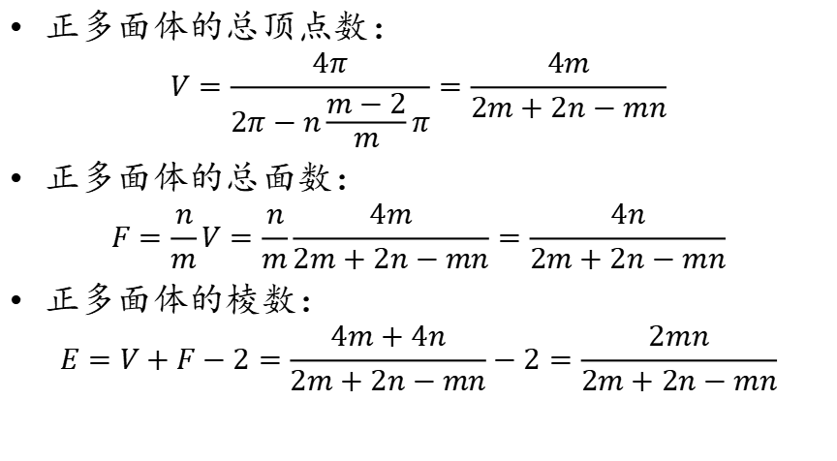
正多面体的相关计算
正多面体的总顶点数：
$$V=\frac{4π}{2π−n\frac{m−2}{m}π}=\frac{4m}{2m+2n−mn}$$
正多面体的总面数：
$$F=\frac{n}{m}V=\frac{n}{m}\frac{4m}{2m+2n−mn}=\frac{4n}{2m+2n−mn}$$
正多面体的棱数：
$$E=V+F−2=\frac{4m+4n}{2m+2n−mn}−2=\frac{2mn}{2m+2n−mn}$$

Slide 11
正四面体
顶点坐标：
(1, 1, 1)
(1, –1, –1)
(–1, 1, –1)
(–1, –1, 1)
m = 3, n = 3
V = 4, F = 4, E = 6

Slide 12
正六面体(立方体)
顶点坐标：
(±1, ±1, ±1)
m = 4, n = 3
V = 8, F = 6, E = 12

Slide 13
正八面体
顶点坐标：
(±1, 0, 0)
(0, ±1, 0)
(0, 0, ±1)
m = 3, n = 4
V = 6, F = 8, E = 12

Slide 14
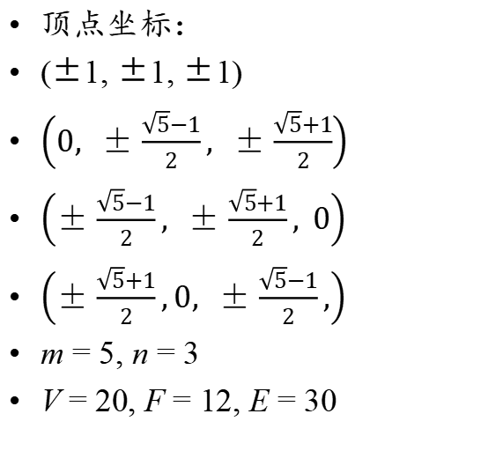
正﻿十二面体
顶点坐标：
(±1, ±1, ±1)
$\left(0, ±\frac{\sqrt{5}−1}{2}, ±\frac{\sqrt{5}+1}{2}\right)$
$\left(±\frac{\sqrt{5}−1}{2}, ±\frac{\sqrt{5}+1}{2}, 0\right)$
$\left(±\frac{\sqrt{5}+1}{2},0, ±\frac{\sqrt{5}−1}{2},\right)$
m = 5, n = 3
V = 20, F = 12, E = 30

Slide 15
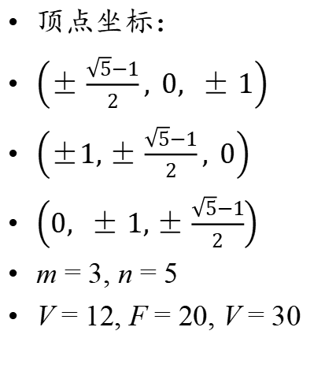
正二﻿十面体
顶点坐标：
$\left(±\frac{\sqrt{5}−1}{2}, 0, ±1\right)$
$\left(±1,±\frac{\sqrt{5}−1}{2}, 0\right)$
$\left(0, ±1,±\frac{\sqrt{5}−1}{2}\right)$
m = 3, n = 5
V = 12, F = 20, V = 30

Slide 16
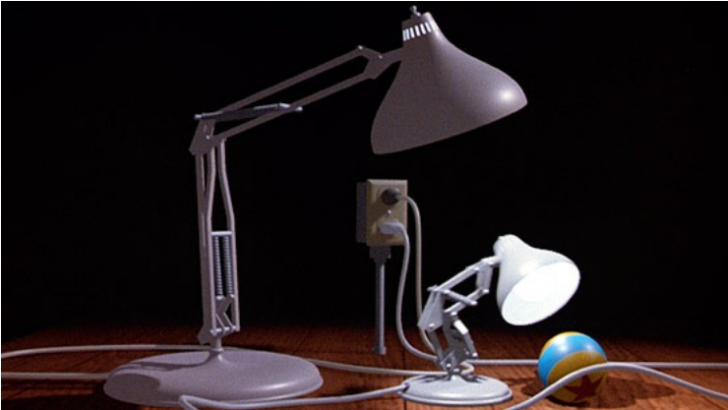
Recap: How to make it?
Modeling
Geometry
Materials
Lighting
Animation
Make it move
Rendering
I.e., draw the picture!
Lighting, shadows, textures...

Slide 17
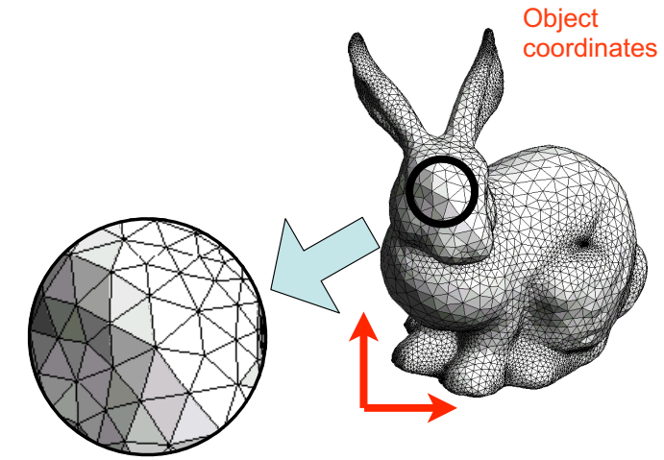
3D→2D
Model the geometry
A triangle mesh with specified materials

Slide 18
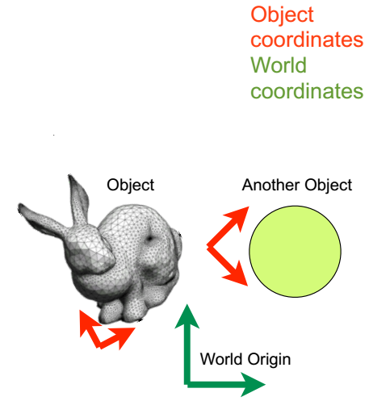
3D→2D
Model the geometry
Place the objects in world space
Each object has its own object space
Only one world space

Slide 19
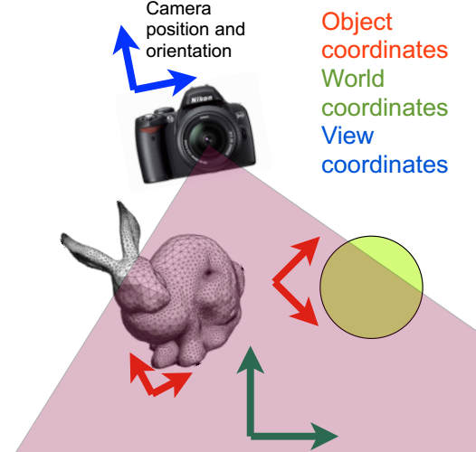
3D→2D
Model the geometry
Place the objects in world space
Pick viewing position and direction

Slide 20
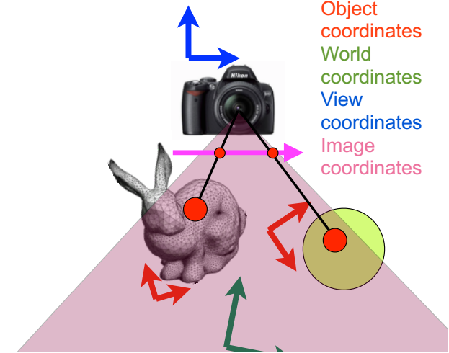
3D→2D
Model the geometry
Place the objects in world space
Pick viewing position and direction
Transform objects to view space and project to image plane

Slide 21
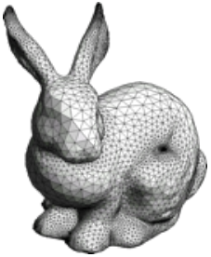
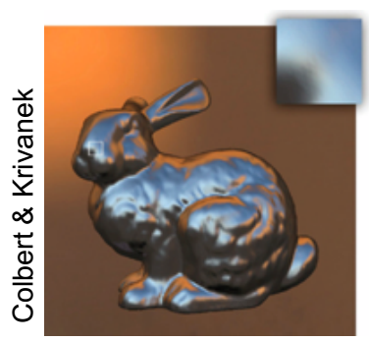
Modern Graphics Pipeline
Input
Geometric model
Triangle vertices, vertex normals,
texture coordinates
Lighting/material model (shader)
Light source positions, colors, intensities, etc.
Texture maps, specular/diffuse coefficients, etc.
Viewpoint + projection plane
Output
Color (+depth) per pixel

Slide 22
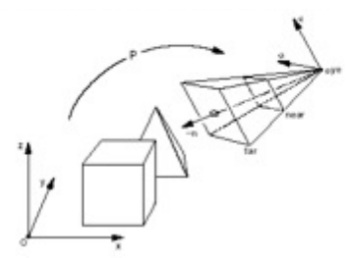
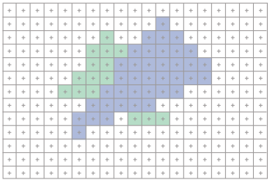
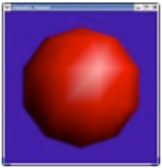
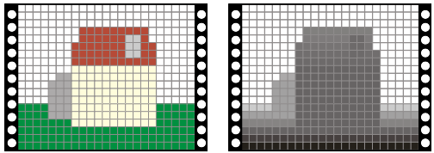
Modern Graphics Pipeline
Project vertices to 2D
(image)
Rasterize triangle: find which
pixels should be lit
Compute per-pixel color
Test visibility (Z-buffer),
update frame buffer color

Slide 23
Classic Graphics Pipeline
Classic diagram
All steps can be implemented in hardware on the graphics card
Vertex
Processor
Clipper and
Primitive Assembler
Vertices
FragmentProcessor
Pixels
Rasterizer

Slide 24
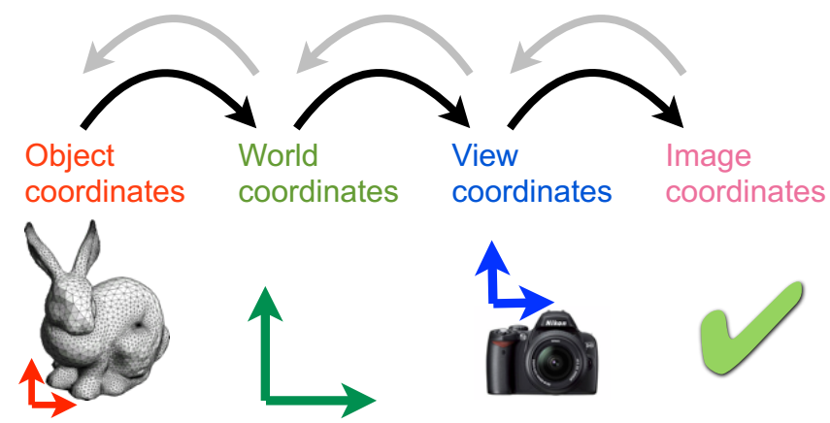
Vertex Processor
Convert object representations from one coordinate
system to another
Every change of coordinates is equivalent to a matrix transformation
Vertex processor also computes vertex colors

Slide 25
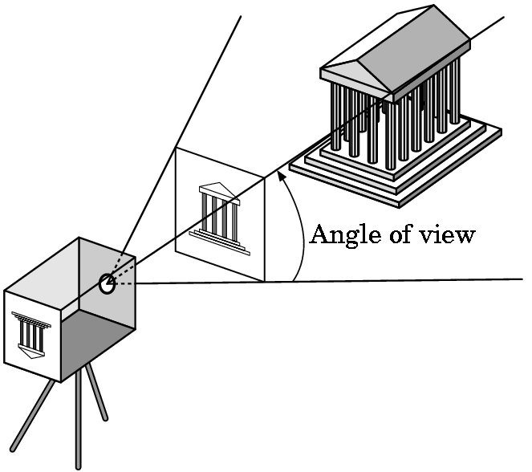
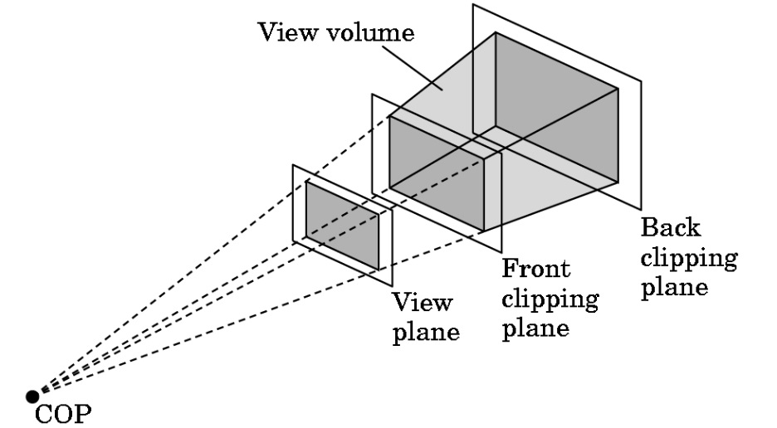
Clipper and Primitive Assembler
Just as a real camera cannot “see” the whole world, the virtual camera can only see part of the world or object space
Objects that are not within this volume are said to be clipped out of the scene
Vertices must be collected into geometric objects before clipping and rasterization can take place

Slide 26
Rasterizer
If an object is not clipped out, the appropriate pixels in the frame buffer must be assigned colors
Rasterizer produces a set of fragments for each object
Fragments are “potential pixels”
Have a location in frame bufffer
Color and depth attributes
Vertex attributes are interpolated over objects by the rasterizer

Slide 27
Fragment Processor
Fragments are processed to determine the color of the corresponding pixel in the frame buffer
Colors can be determined by texture mapping or interpolation of vertex colors
Fragments may be blocked by other fragments closer to the camera
Hidden-surface removal

Slide 28
Modern Graphics Pipeline
Project vertices to 2D
(image)
Rasterize triangle: find which
pixels should be lit
Compute per-pixel color
Test visibility (Z-buffer),
update frame buffer color

Slide 29
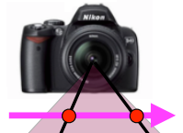
Coordinates
Transformations between these coordinates

Slide 30
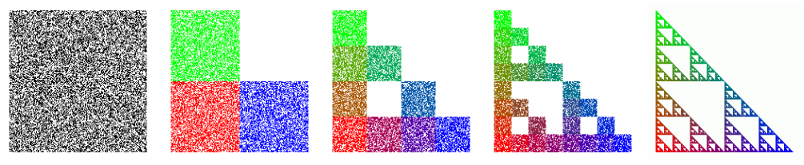
Transformations
What is a Transformation?
Maps points (x, y) in one coordinate system to points (x', y') in another coordinate system
x' = ax + by + c y' = dx + ey + f
Applications: animation, deformation, viewing, projection, real-time shadows, …
For example, Iterated Function System (IFS):

Slide 31
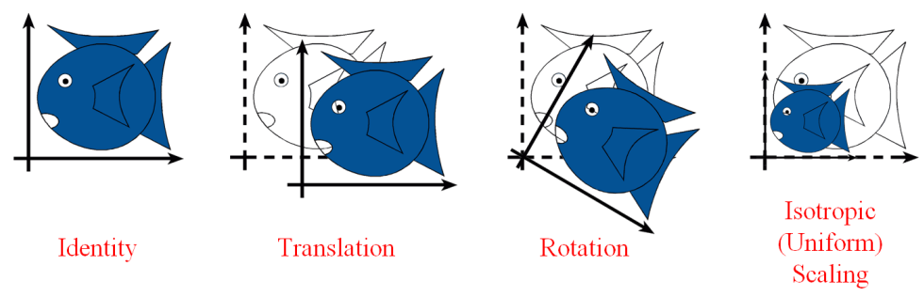
Simple Transformations
Can be combined
Are these operations invertible?
Yes, except scale = 0

Slide 32
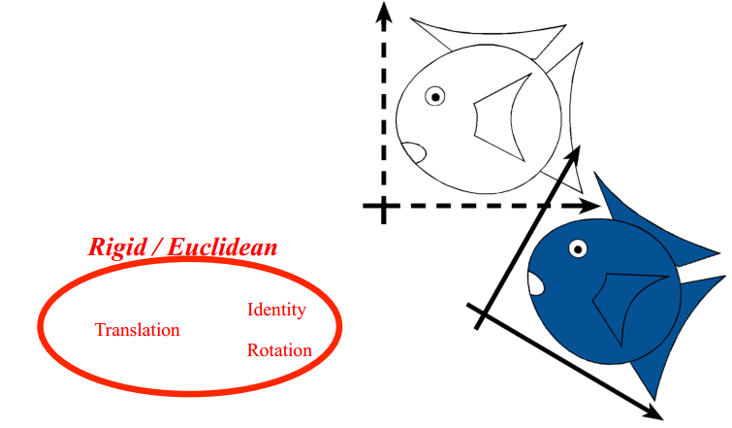
Euclidean/Rigid-Body Transforms
Preserves distances
Preserves angles

Slide 33
刚体变换
P是一个从R^{n}到R^{n}的线性变换矩阵，如果对任意的向量u, v∈R^{n}，有
(Pu)·(Pv) = u·v
则称P对应的变换是刚体变换
设P = [p₁, p₂, …, p_{n}]，分别取u = e_{i}, v = e_{j}，则
Pe_{i} = p_{i}, Pe_{j} = p_{j}
p_{i}·p_{j} = (Pe_{i})·(Pe_{j}) = e_{i}·e_{j}
刚体变换可以确保被变换的向量之间的相对位置不变，它对应的矩阵是正交矩阵

Slide 34
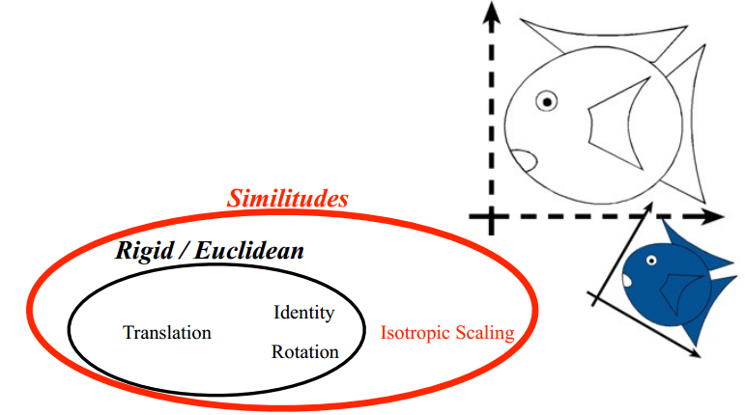
Similarity / Similitudes Transforms
Preserves angles
The shapes are the same, just at different scale, orientation and location

Slide 35
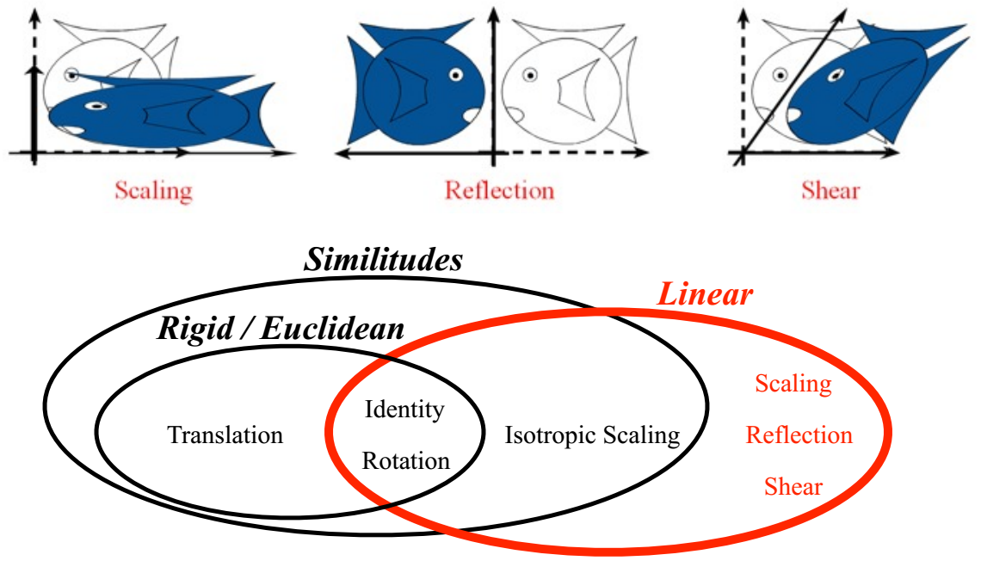
Linear Transformations

Slide 36
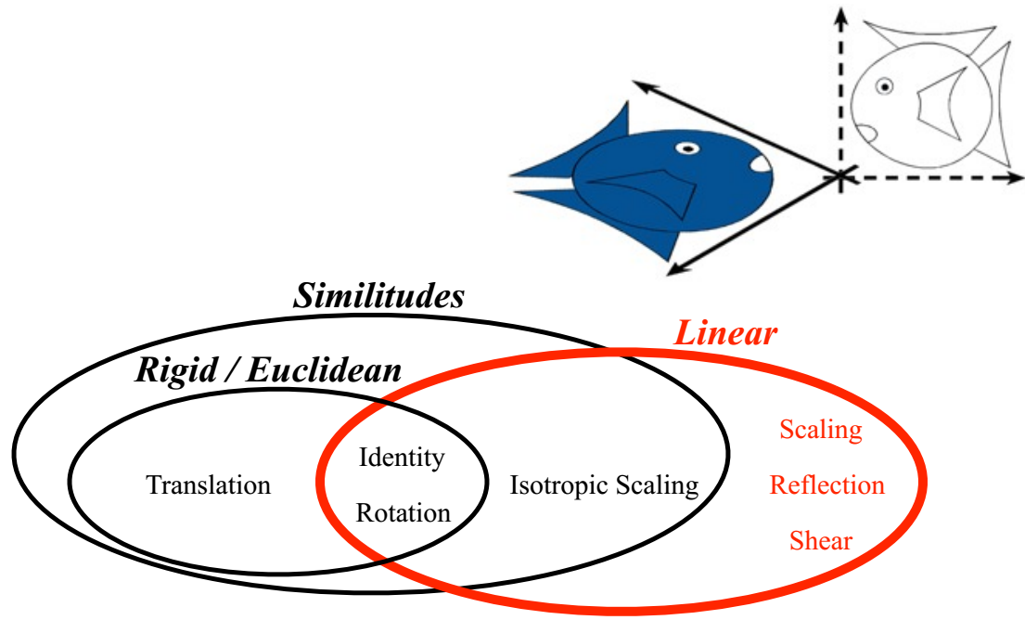
Linear Transformations
L(p + q) = L(p) + L(q)
L(ap) = aL(p)

Slide 37
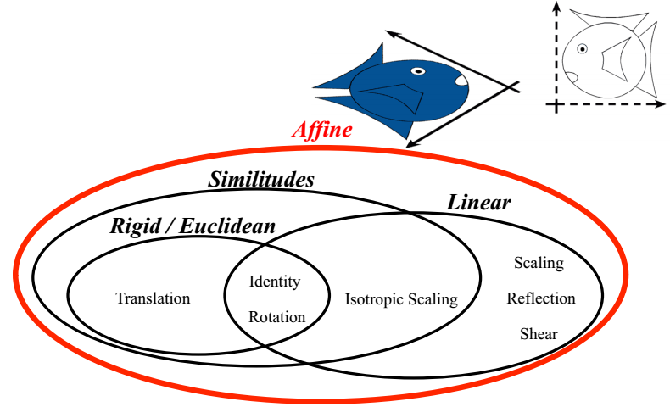
Affine Transformations
Preserves parallel lines

Slide 38
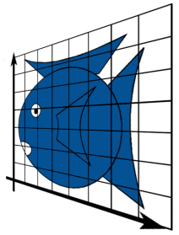
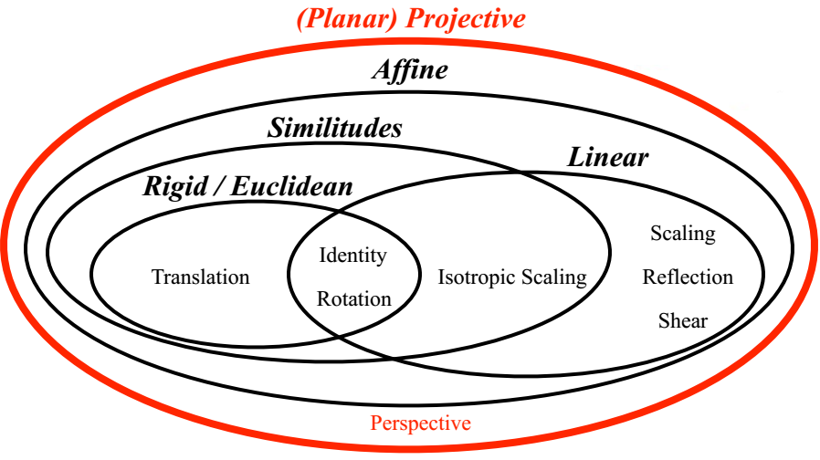
Projective Transformations
preserves lines: lines remain lines (planes remain planes in 3D)

Slide 39
What’s so nice about these?
What’s with the hierarchy? Why have we grouped types of transformations with and within each other?

Slide 40
What’s so nice about these?
They are closed under concatenation
Means e.g. that an affine transformation followed by another affine transformation is still an affine transformation
Same for every subgroup, e.g. rotations, translations..
Very convenient!
Projections are the most general
Others are its special cases

Slide 41
Group Theory
Remember algebra?
A group is a set S with an operation f that takes two elements of S and produces a third:
s, t ∈ S, f(s, t) = u ⇒ u ∈ S
(and some other axioms)
These transformations are group(s) and subgroups
The transformations are the set S, concatenation of transformations is f

Slide 42
群论的发展历史
9世纪，阿拉伯数学家阿里·花拉子模引入代数思想，导出一元二次方程求根公式
16世纪，意大利数学家卡尔达诺和费尔拉利发表一元三次方程和四次方程求根公式
18世纪，法国数学家拉格朗日最早提出了群的相关概念
19世纪上半叶，挪威数学家阿贝尔和法国数学家伽罗瓦用群论证明了字母系数的5次和5次以上方程无根式解，和判断数字系数有根式解的条件
19世纪中叶，群论逐渐被数学界接受，并应用在了更多领域

Slide 43
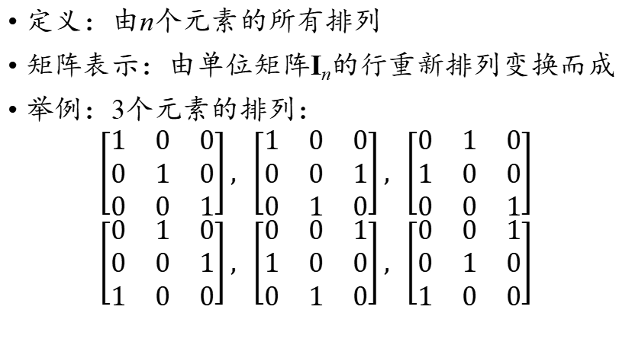
置换群
定义：由n个元素的所有排列
矩阵表示：由单位矩阵I_{n}的行重新排列变换而成
举例：3个元素的排列：
$$\left[\begin{matrix}1 & 0 & 0 \\ 0 & 1 & 0 \\ 0 & 0 & 1\end{matrix}\right], \left[\begin{matrix}1 & 0 & 0 \\ 0 & 0 & 1 \\ 0 & 1 & 0\end{matrix}\right], \left[\begin{matrix}0 & 1 & 0 \\ 1 & 0 & 0 \\ 0 & 0 & 1\end{matrix}\right]$$
$$\left[\begin{matrix}0 & 1 & 0 \\ 0 & 0 & 1 \\ 1 & 0 & 0\end{matrix}\right], \left[\begin{matrix}0 & 0 & 1 \\ 1 & 0 & 0 \\ 0 & 1 & 0\end{matrix}\right], \left[\begin{matrix}0 & 0 & 1 \\ 0 & 1 & 0 \\ 1 & 0 & 0\end{matrix}\right]$$

Slide 44
元素的轨道
设A是n元置换群中的一个元素对应的矩阵
对于向量v = (1, 2, …, n)^{T}
v, Av, A²v……, 只能有有限种排列
必然存在0 ≤ k < l，使得A^{k}v = A^{l}v
根据A可逆，有A^{l – k}v = v
v中的每个元素，在有限次置换后，总能回到原来的位置
v的第i个元素在置换过程中遍历的位置的循环序列称为它的轨道

Slide 45
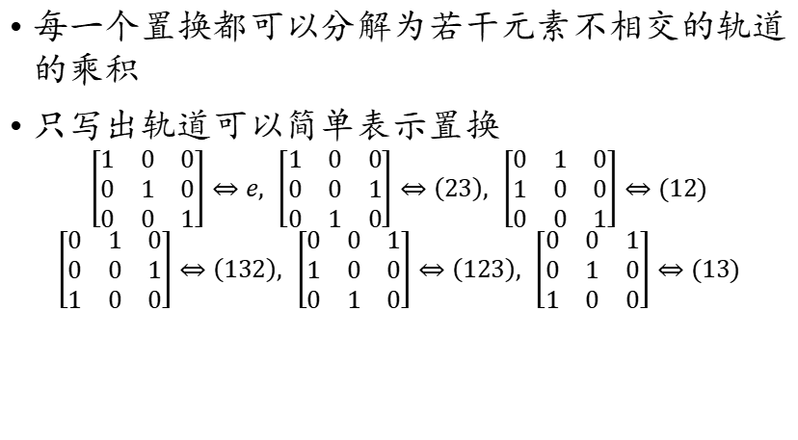
置换元素的简单表示
每一个置换都可以分解为若干元素不相交的轨道的乘积
只写出轨道可以简单表示置换
$$\left[\begin{matrix}1 & 0 & 0 \\ 0 & 1 & 0 \\ 0 & 0 & 1\end{matrix}\right]⇔e, \left[\begin{matrix}1 & 0 & 0 \\ 0 & 0 & 1 \\ 0 & 1 & 0\end{matrix}\right]⇔\left(23\right), \left[\begin{matrix}0 & 1 & 0 \\ 1 & 0 & 0 \\ 0 & 0 & 1\end{matrix}\right]⇔(12)$$
$$\left[\begin{matrix}0 & 1 & 0 \\ 0 & 0 & 1 \\ 1 & 0 & 0\end{matrix}\right]⇔\left(132\right), \left[\begin{matrix}0 & 0 & 1 \\ 1 & 0 & 0 \\ 0 & 1 & 0\end{matrix}\right]⇔\left(123\right), \left[\begin{matrix}0 & 0 & 1 \\ 0 & 1 & 0 \\ 1 & 0 & 0\end{matrix}\right]⇔(13)$$

Slide 46
排列的奇偶性
任何排列都能通过有限次对换得到
123的6种排列：e, (12), (23), (13), (123), (132)
其中
e, (123), (132)只能对123做偶数次对换得到，称为偶排列
(12), (23), (13)只能对123做奇数次对换得到，称为奇排列
n个数有n!种排列，奇排列和偶排列各占一半
两个奇排列的复合得到偶排列

Slide 47
排列奇偶性的应用
1
2
1
2
?
3
4
5
3
4
5
6
7
8
6
8
7
能否在不把方块取出的前提下，利用左上角的空，通过调整方块位置，把左图转化为右图？

Slide 48
排列奇偶性的应用
0
1
2
0
1
2
×
3
4
5
3
4
5
6
7
8
6
8
7
求解关键：把空也视为一个方块，标记为0
每次调整相当于把0与其它方块对换
只能通过偶数次对换让0回到左上角
如果不取出方块，只能通过调整得到偶排列

Slide 49
置换群的特点
n元置换群总共有n!个元素
置换群两个元素的乘法定义为对应矩阵乘积对应的元素
置换群元素的乘法不满足交换率
置换群中表示偶排列的元素构成的集合也满足乘法封闭的性质，称为交错群
n元交错群共有n!/2个元素

Slide 50
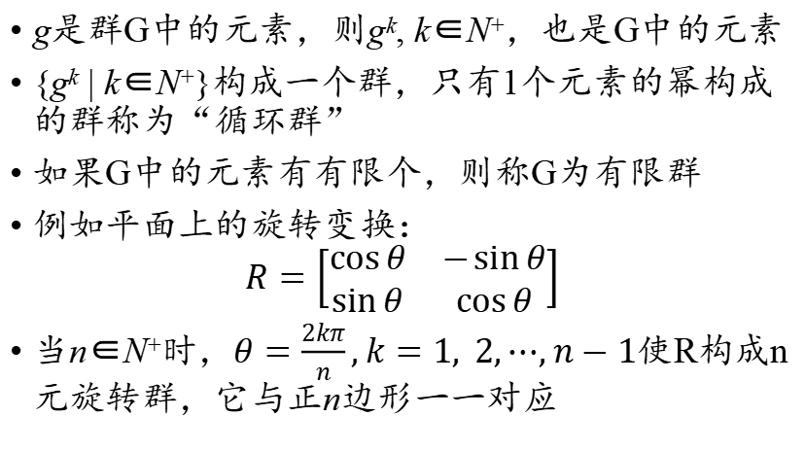
有限群
g是群G中的元素，则g^{k}, k∈N⁺，也是G中的元素
{g^{k} | k∈N⁺}构成一个群，只有1个元素的幂构成的群称为“循环群”
如果G中的元素有有限个，则称G为有限群
例如平面上的旋转变换：
$$R=\left[\begin{matrix}\cos{θ} & −\sin{θ} \\ \sin{θ} & \cos{θ}\end{matrix}\right]$$
当n∈N⁺时，$θ=\frac{2kπ}{n},k=1, 2,⋯,n−1$使R构成n元旋转群，它与正n边形一一对应

Slide 51
三维空间中的有限旋转变换群
三维空间中的有限刚体变换群只有5类，每一类对应着一个正多面体

Slide 52
Transforms are Groups
Why is this useful?
You can represent any number of successive transformations by a single compound transformation
Example
The object-to-world transformation, the world-to-view transformation, and the perspective projection (view-to-image) can all be folded into a single projective object-to image transformation
Object coordinates
↓
World coordinates
↓
View Coordinates
↓
Image Coordinates

Slide 53
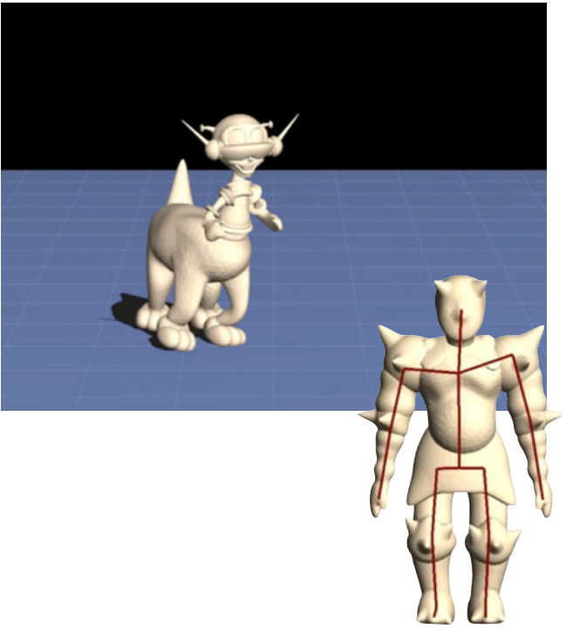
More Complex Transformations..
...can be built out of these, e.g.
Skinning
Blending of affine transformations

Slide 54
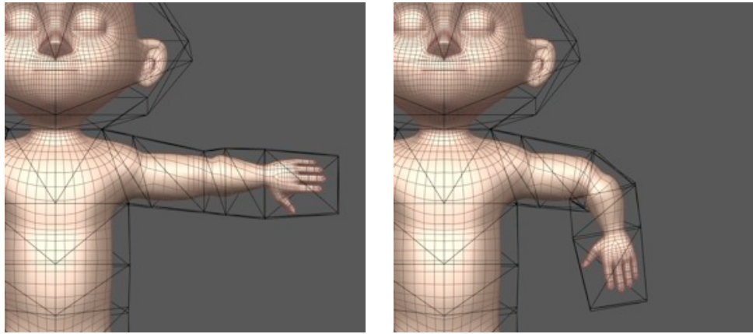
More Complex Transformations..
Harmonic coordinates
Object enclosed in simple “cage”, each object point knows the influence each cage vertex has on it
Deform the cage, and the object moves!

Slide 55
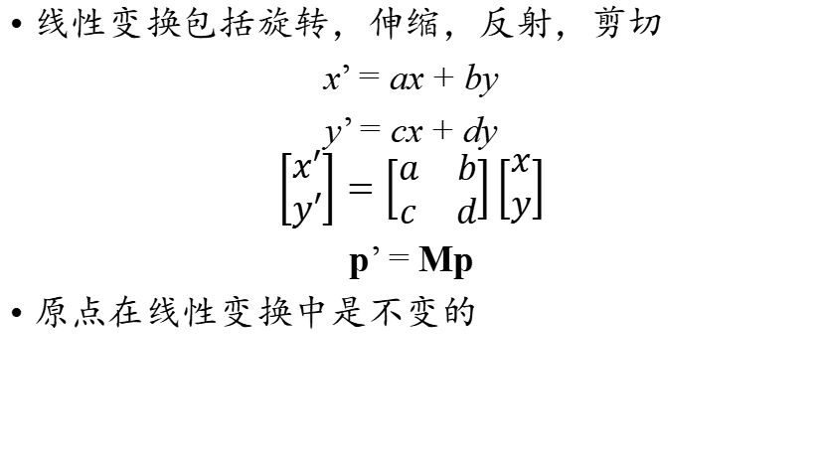
How are Linear Transforms Represented?
线性变换包括旋转，伸缩，反射，剪切
x’ = ax + by
y’ = cx + dy
$$\left[\begin{aligned}x′ \\ y′\end{aligned}\right]=\left[\begin{matrix}a & b \\ c & d\end{matrix}\right]\left[\begin{aligned}x \\ y\end{aligned}\right]$$
p’ = Mp
原点在线性变换中是不变的

Slide 56
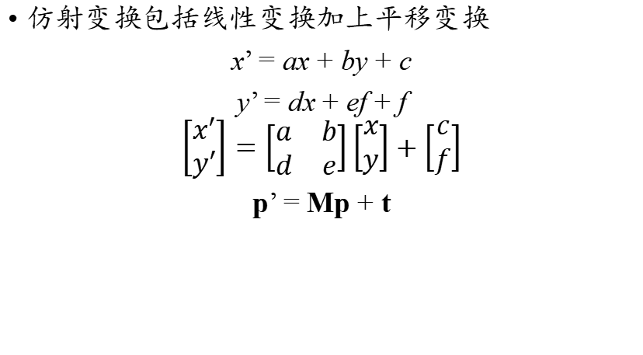
How are Linear Transforms Represented?
仿射变换包括线性变换加上平移变换
x’ = ax + by + c
y’ = dx + ef + f
$$\left[\begin{aligned}x′ \\ y′\end{aligned}\right]=\left[\begin{matrix}a & b \\ d & e\end{matrix}\right]\left[\begin{aligned}x \\ y\end{aligned}\right]+\left[\begin{aligned}c \\ f\end{aligned}\right]$$
p’ = Mp + t

Slide 57
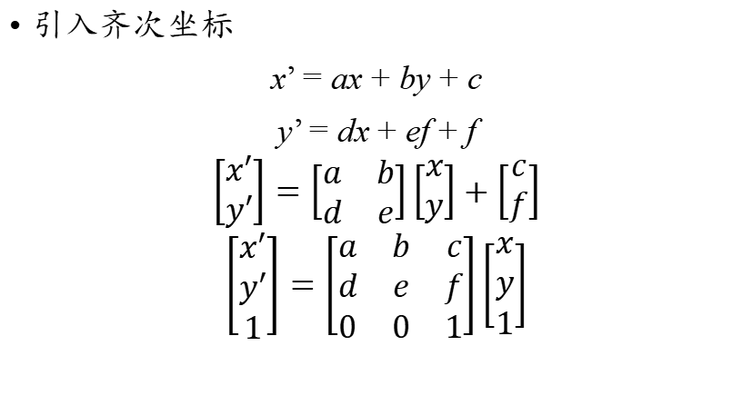
使用矩阵表示仿射变换
引入齐次坐标
x’ = ax + by + c
y’ = dx + ef + f
$$\left[\begin{aligned}x′ \\ y′\end{aligned}\right]=\left[\begin{matrix}a & b \\ d & e\end{matrix}\right]\left[\begin{aligned}x \\ y\end{aligned}\right]+\left[\begin{aligned}c \\ f\end{aligned}\right]$$
$$\left[\begin{aligned}x′ \\ y′ \\ 1\end{aligned}\right]=\left[\begin{matrix}a & b & c \\ d & e & f \\ 0 & 0 & 1\end{matrix}\right]\left[\begin{aligned}x \\ y \\ 1\end{aligned}\right]$$

Slide 58



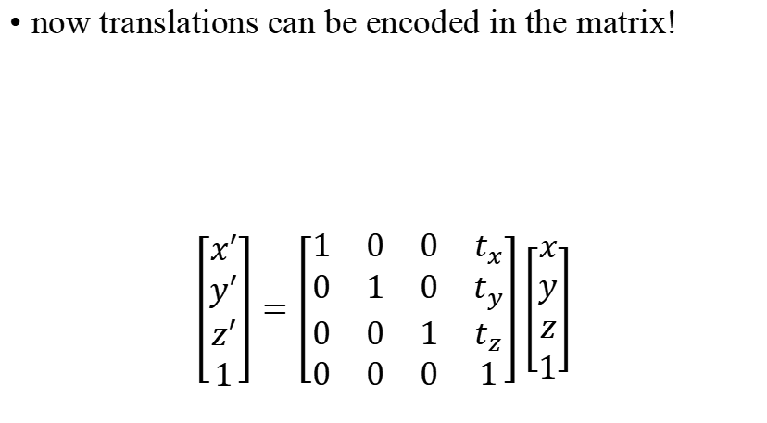
Translate (t_{x}, t_{y}, t_{z})
now translations can be encoded in the matrix!
$$\left[\begin{aligned}x′ \\ y′ \\ z′ \\ 1\end{aligned}\right]=\left[\begin{matrix}1 & 0 & 0 & t_{x} \\ 0 & 1 & 0 & t_{y} \\ 0 & 0 & 1 & t_{z} \\ 0 & 0 & 0 & 1\end{matrix}\right]\left[\begin{aligned}x \\ y \\ z \\ 1\end{aligned}\right]$$
$$\left[\begin{aligned}x′ \\ y′ \\ z′\end{aligned}\right]$$
$$\left[\begin{aligned}t_{x} \\ t_{y} \\ t_{z}\end{aligned}\right]$$
$$\left[\begin{aligned}x \\ y \\ z\end{aligned}\right]$$

Slide 59
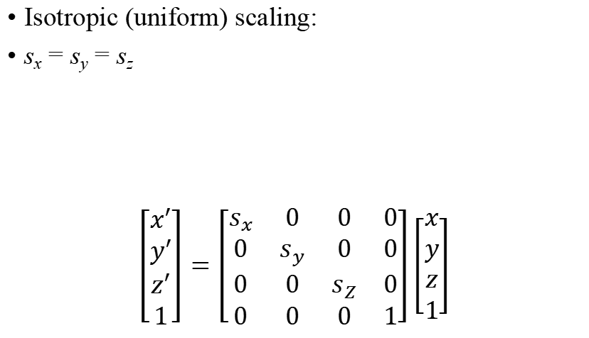
Scale (s_{x}, s_{y}, s_{z})
Isotropic (uniform) scaling:
s_{x} = s_{y} = s_{z}
$$\left[\begin{aligned}x′ \\ y′ \\ z′ \\ 1\end{aligned}\right]=\left[\begin{matrix}s_{x} & 0 & 0 & 0 \\ 0 & s_{y} & 0 & 0 \\ 0 & 0 & s_{Z} & 0 \\ 0 & 0 & 0 & 1\end{matrix}\right]\left[\begin{aligned}x \\ y \\ z \\ 1\end{aligned}\right]$$
y
p'
p
Scale(s, s, s)
q'
q
x

Slide 60
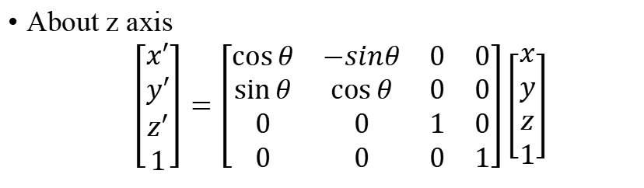
Rotation
z
p'
θ
p
x
y
About z axis $$\left[\begin{aligned}x′ \\ y′ \\ z′ \\ 1\end{aligned}\right]=\left[\begin{matrix}\cos{θ} & −sinθ & 0 & 0 \\ \sin{θ} & \cos{θ} & 0 & 0 \\ 0 & 0 & 1 & 0 \\ 0 & 0 & 0 & 1\end{matrix}\right]\left[\begin{aligned}x \\ y \\ z \\ 1\end{aligned}\right]$$

Slide 61
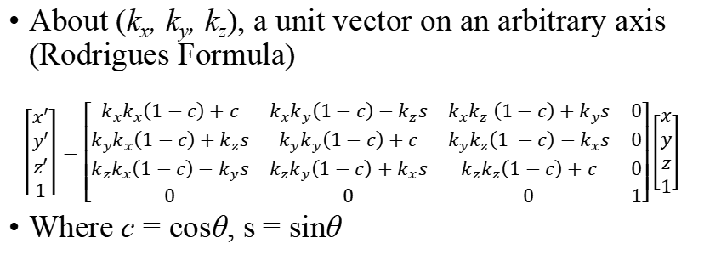
Rotation
k
p
θ
p'
About (k_{x}, k_{y}, k_{z}), a unit vector on an arbitrary axis (Rodrigues Formula)
$$\left[\begin{aligned}x′ \\ y′ \\ z′ \\ 1\end{aligned}\right]=\left[\begin{matrix}k_{x}k_{x}\left(1−c\right)+c & k_{x}k_{y}\left(1−c\right)−k_{z}s & k_{x}k_{z} \left(1−c\right)+k_{y}s & 0 \\ k_{y}k_{x}\left(1−c\right)+k_{z}s & k_{y}k_{y}\left(1−c\right)+c & k_{y}k_{z}\left(1 −c\right)−k_{x}s & 0 \\ k_{z}k_{x}\left(1−c\right)−k_{y}s & k_{z}k_{y}\left(1−c\right)+k_{x}s & k_{z}k_{z}\left(1−c\right)+c & 0 \\ 0 & 0 & 0 & 1\end{matrix}\right]\left[\begin{aligned}x \\ y \\ z \\ 1\end{aligned}\right]$$
Where c = cosθ, s = sinθ

Slide 62
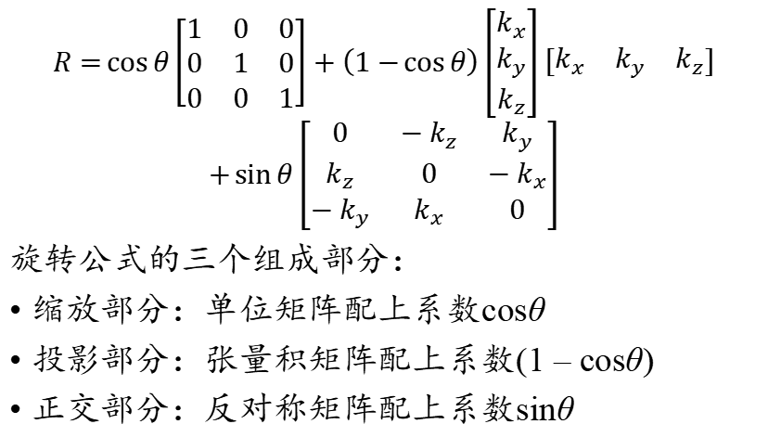
旋转公式的记忆法则
$$R=\cos{θ}\left[\begin{matrix}1 & 0 & 0 \\ 0 & 1 & 0 \\ 0 & 0 & 1\end{matrix}\right]+\left(1−\cos{θ}\right)\left[\begin{matrix}k_{x} \\ k_{y} \\ k_{z}\end{matrix}\right]\left[\begin{matrix}k_{x} & k_{y} & k_{z}\end{matrix}\right]$$
$$+\sin{θ}\left[\begin{matrix}0 & −k_{z} & k_{y} \\ k_{z} & 0 & −k_{x} \\ −k_{y} & k_{x} & 0\end{matrix}\right]$$
旋转公式的三个组成部分：
缩放部分：单位矩阵配上系数cosθ
投影部分：张量积矩阵配上系数(1 – cosθ)
正交部分：反对称矩阵配上系数sinθ

Slide 63
旋转公式的推导思路
向量方程法：把被旋转的向量分解为沿旋转轴和垂直旋转轴的部分，用微分方程求解垂直于旋转轴的部分
微分方程法：把旋转变换视为一种运动，求解转动的微分方程
复合变换法：把旋转变换视为两个反射变换的乘积，对矩阵运算做推导

Slide 64
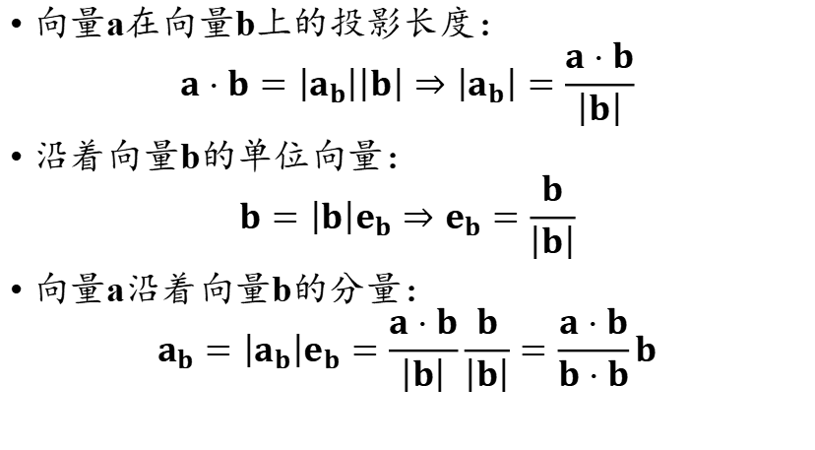
利用点积构造投影
a
向量a在向量b上的投影长度：
$$a⋅b=\left|a_{b}\right|\left|b\right|⇒\left|a_{b}\right|=\frac{a⋅b}{\left|b\right|}$$
沿着向量b的单位向量：
$$b=\left|b\right|e_{b}⇒e_{b}=\frac{b}{\left|b\right|}$$
向量a沿着向量b的分量：
$$a_{b}=\left|a_{b}\right|e_{b}=\frac{a⋅b}{\left|b\right|}\frac{b}{\left|b\right|}=\frac{a⋅b}{b⋅b}b$$
e_{b}
a_{b}
b

Slide 65
利用点积构造投影
u是一个单位向量，u·u = 1
向量x在u上的投影：x₁ = (x·u)u
如何构造从x到x₁的映射矩阵？
x₁ = (x·u)u = u(u·x) = u(u^{T}x) = (uu^{T})x
uu^{T}即是计算x沿着u方向的映射矩阵
x垂直u方向的向量计算：
x₂ = x – x₁ = Ix – (uu^{T})x = (I – uu^{T})x

Slide 66
利用叉积构造旋转
ω是一个单位向量，计算u绕ω旋转角度θ得到的向量v
先设u⊥ω，则有
u×v = |u|²sinθω
(u×v)×u = |u|²sinθω×u
|u|²v – (u·v)u = |u|²sinθω×u
v – cosθu = sinθω×u
v = cosθu + sinθω×u
ω
v
θ
u

Slide 67
利用叉积构造旋转
对于任意情况，把u分解为沿着k的部分u₁和垂直于k的部分u₂:
u₁ = (k·u)k
u₂ = u – (k·u)k
计算u₂旋转以后的向量v₂：
v₂ = cosθu₂ + sinθk×u₂ = cosθ(u – u₁) + sinθk×u
u₁沿着ω，旋转以后不变，因而
v = u₁ + v₂ = cosθu + (1 – cosθ)u₁ + sinθk×u
= cosθu + (1 – cosθ)(k·u)k + sinθk×u

Slide 68
反对称矩阵及其性质
A是一个n×n矩阵，如果A^{T} = –A，则称A是一个反对称矩阵
反对称矩阵的元素关系，对任意的i, j ∈{1, 2, …, n}：
a_{ij} = – a_{ji}
a_{ii} = – a_{ii} = 0
对任意的u, v∈R^{n}
u·(Av) = u^{T}Av = –u^{T}A^{T}v = –(Au)^{T}v = –(Au)·v
特别的
v·(Av) = – v·(Av) = 0

Slide 69
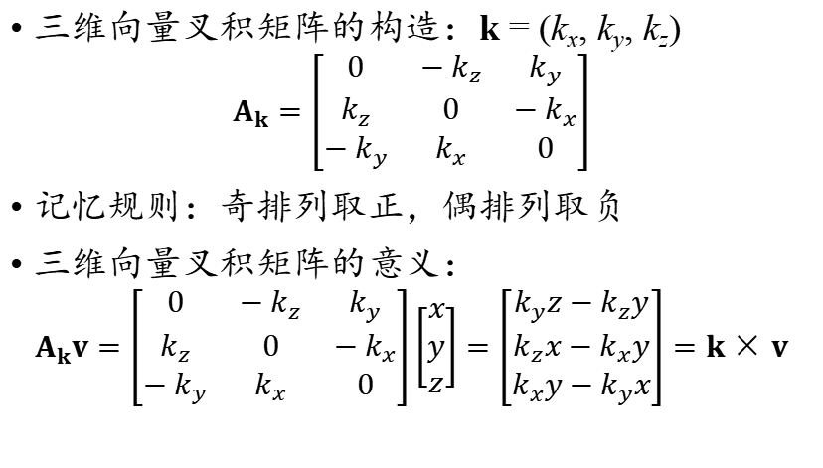
三维向量的叉积矩阵
三维向量叉积矩阵的构造：k = (k_{x}, k_{y}, k_{z})
$$A_{k}=\left[\begin{matrix}0 & −k_{z} & k_{y} \\ k_{z} & 0 & −k_{x} \\ −k_{y} & k_{x} & 0\end{matrix}\right]$$
记忆规则：奇排列取正，偶排列取负
三维向量叉积矩阵的意义：
$$A_{k}v=\left[\begin{matrix}0 & −k_{z} & k_{y} \\ k_{z} & 0 & −k_{x} \\ −k_{y} & k_{x} & 0\end{matrix}\right]\left[\begin{matrix}x \\ y \\ z\end{matrix}\right]=\left[\begin{matrix}k_{y}z−k_{z}y \\ k_{z}x−k_{x}y \\ k_{x}y−k_{y}x\end{matrix}\right]=k×v$$

Slide 70
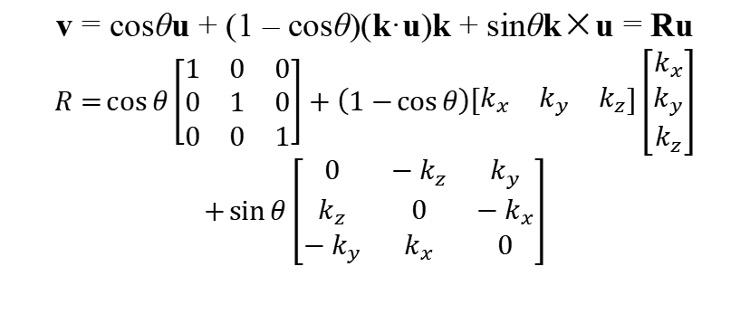
旋转公式的矩阵形式
v = cosθu + (1 – cosθ)(k·u)k + sinθk×u = Ru
$$R=\cos{θ}\left[\begin{matrix}1 & 0 & 0 \\ 0 & 1 & 0 \\ 0 & 0 & 1\end{matrix}\right]+\left(1−\cos{θ}\right)\left[\begin{matrix}k_{x} & k_{y} & k_{z}\end{matrix}\right]\left[\begin{matrix}k_{x} \\ k_{y} \\ k_{z}\end{matrix}\right]$$
$$+\sin{θ}\left[\begin{matrix}0 & −k_{z} & k_{y} \\ k_{z} & 0 & −k_{x} \\ −k_{y} & k_{x} & 0\end{matrix}\right]$$

Slide 71
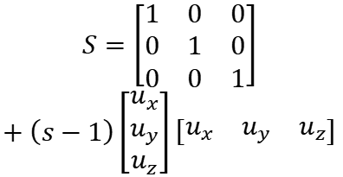
三维空间任意方向伸缩
u
$$S=\left[\begin{matrix}1 & 0 & 0 \\ 0 & 1 & 0 \\ 0 & 0 & 1\end{matrix}\right]$$
$$+\left(s−1\right)\left[\begin{matrix}u_{x} \\ u_{y} \\ u_{z}\end{matrix}\right]\left[\begin{matrix}u_{x} & u_{y} & u_{z}\end{matrix}\right]$$
s < 1
s > 1
u是伸缩方向单位向量，满足：
|u|² = u_{x}² + u_{y}² + u_{z}² = 1
s是伸缩比例，当s > 1时拉伸，0 < s < 1时压缩
s = 0时投影，s < 0是反向，s = – 1时反射

